Slide 1
Refactoring to Patterns
유석문

Slide 2
1. Design Patterns

Slide 3

1.1 What are Design Patterns?
Design Patterns catalog object-oriented design ideas that work.
The idea of cataloging what object-oriented design experts had been doing right since time immemorial, but had never written down, really came into its own with the publication of Design Patterns: Elements of Reusable Object-Oriented Software, by Erich Gamma, Richard Helm, Ralph Johnson, and John Vlissides in 1994.

Slide 4
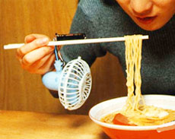
1.1 Patterns Happy?
We are patterns happy when we become so enamored of patterns that we simply must use them in our code.

Slide 5

1.2 Composed Patterns – The Story Tellers
A method composed of calls
to a small number of coherent elements.

Slide 6
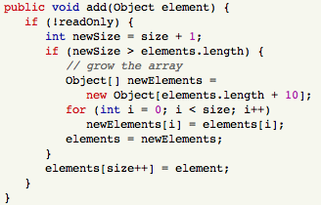
1.2 Composed Patterns – The Story Tellers

Slide 7
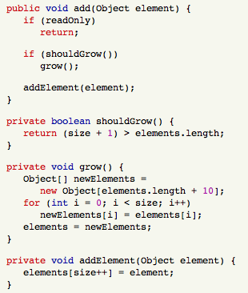
1.2 Composed Patterns – The Story Tellers

Slide 8
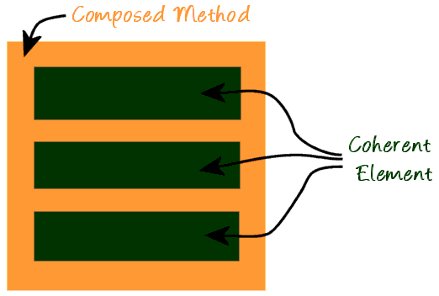
1.2 Composed Patterns – The Story Tellers
Composed Method: An easy-to-understand method that does its work via calls to coherent elements.
Coherent Element: An easily-understood piece of work.

Slide 9
1.2 Composed Patterns – The Story Tellers
"Any fool can write code that a computer can understand! The real trick is to write code that other humans understand." [Refactoring]

Slide 10
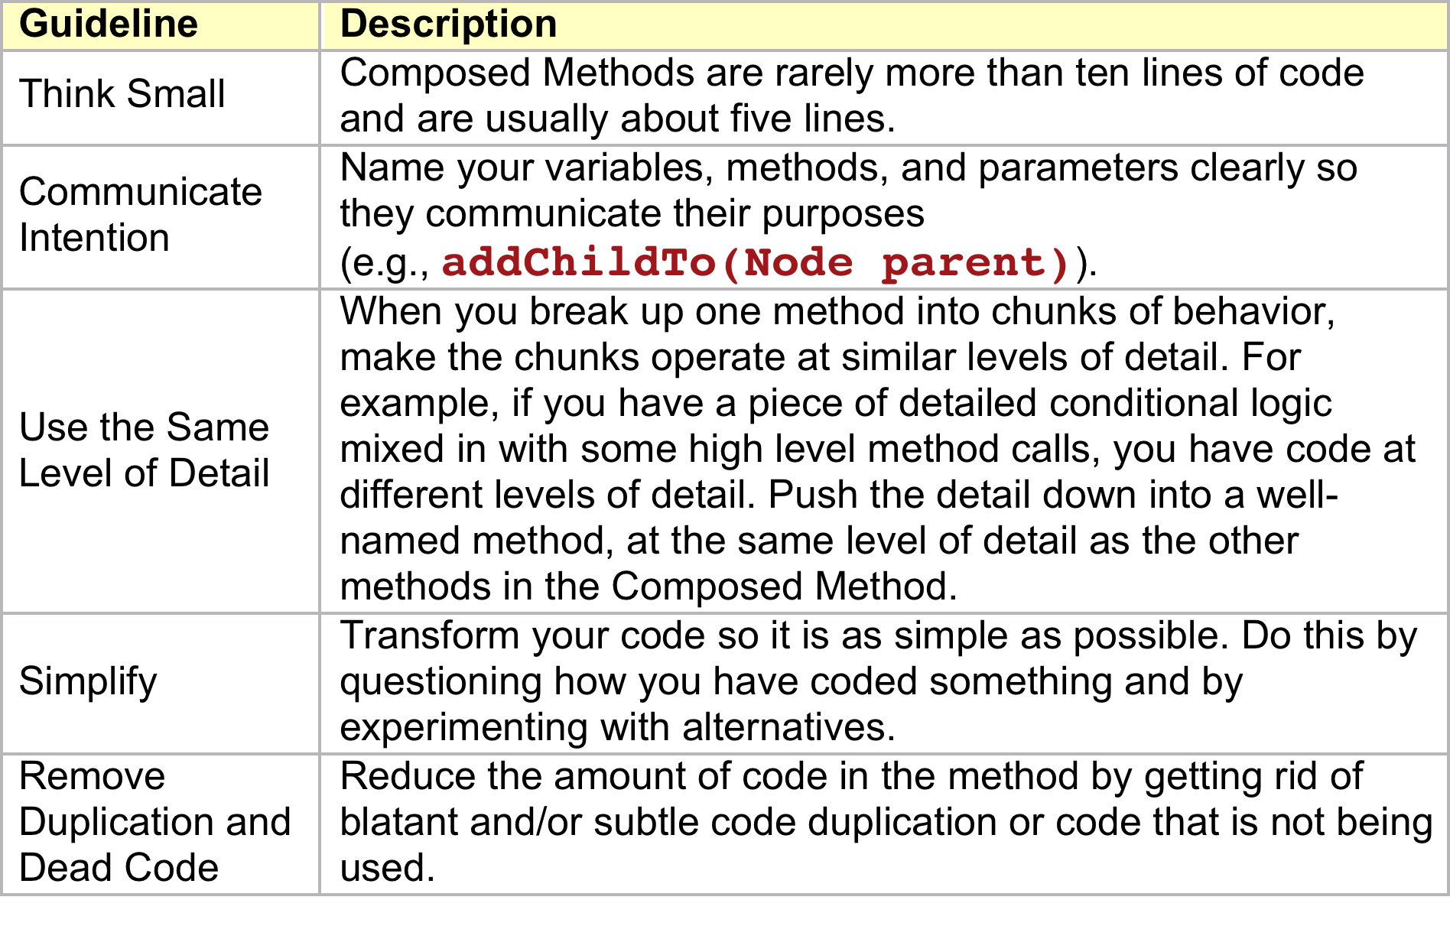
1.2 Composed Patterns – Guidelines For Creating Composed Methods

Slide 11

1.3 Template Method
Define the skeleton of an algorithm in an operation, deferring some steps to subclasses. Template Method lets subclasses redefine certain steps of an algorithm without changing the algorithm's structure.

Slide 12
1.3 Template Method
Template Method
Mandate
Abstract method
Helper
Private method
Hook
Overridable method
Skeleton
Mandate
Mandate
Hook
Filler

Slide 13
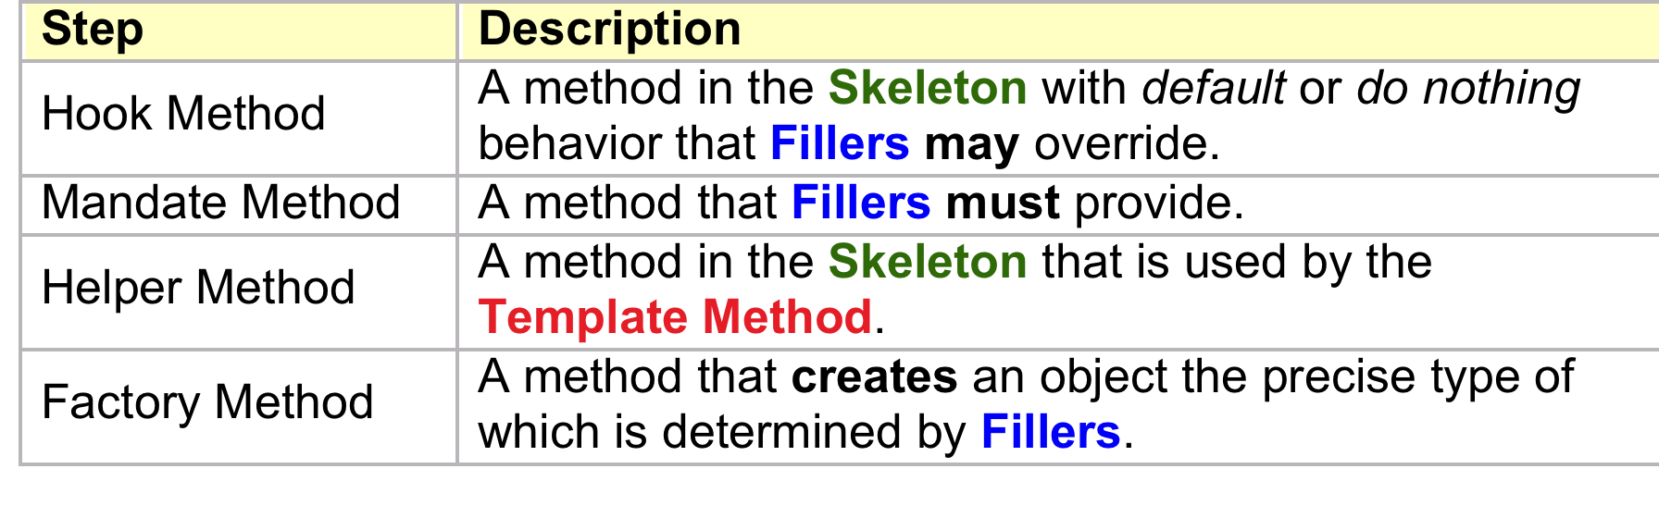
1.3 Template Method
Template Method: A recipe or set of steps that declares what gets done.
Skeleton: The class containing the Template Method.
Filler: A Skeleton subclass that fills in one or more Template Method steps.
Template Method Steps

Slide 14
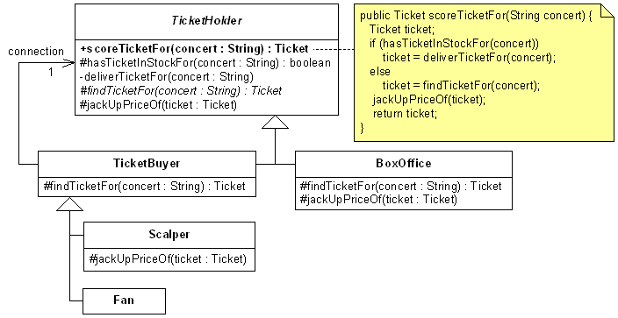
1.3 Template Method - Example
TemplateMethod-ScalperExample-Java.zip

Slide 15
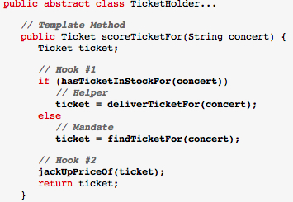
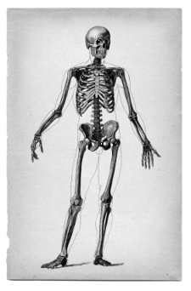
1.3 Template Method - Example
Putting Meat on the Bones

Slide 16
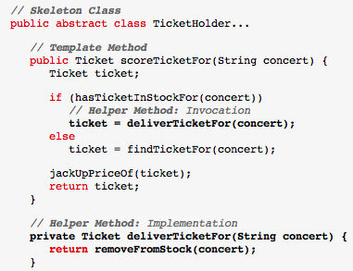
1.3 Template Method - Example
The deliverTicketFor(...) method is a Helper Method

Slide 17
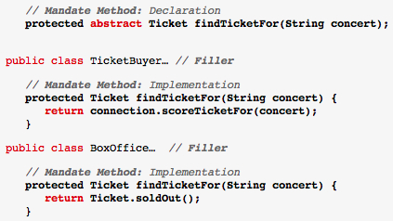
1.3 Template Method - Example
The findTicketFor(...) method in TicketHolder is a Mandate Method: it must be implemented by all Fillers, such as TicketBuyer and BoxOffice:

Slide 18
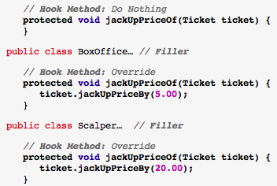

1.3 Template Method - Example
The jackUpPriceOf(...) method in TicketHolder is a Hook Method.

Slide 19
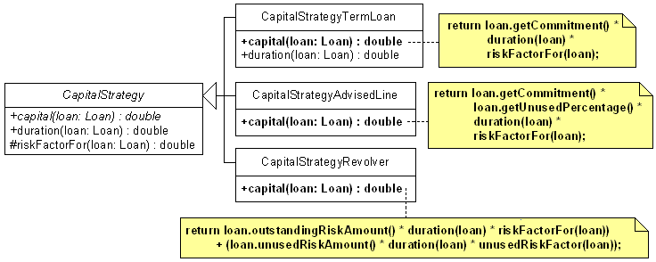
1.3 Template Method - Exercise
TemplateMethod-Problem-Java.zip
Each of the capital(...) methods contains some duplicated code. In this exercise, your job is to remove the duplication by refactoring to a Template Method.

Slide 20
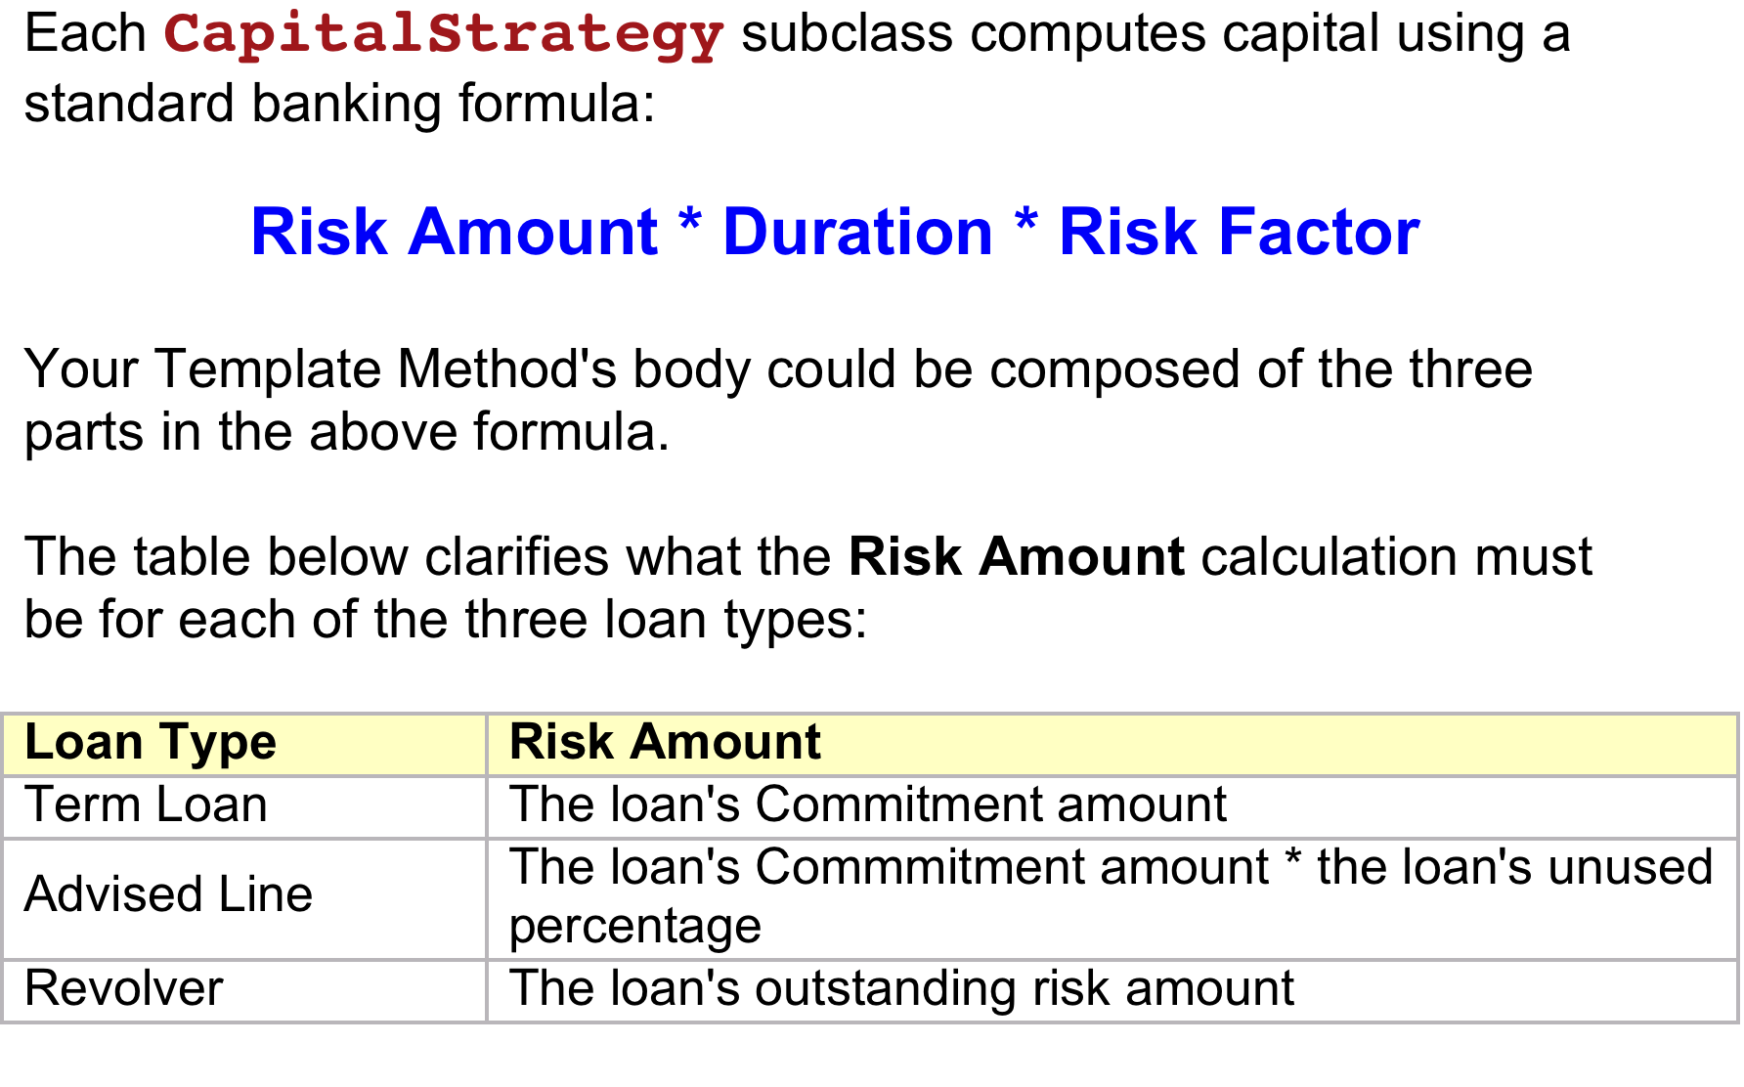
1.3 Template Method - Exercise

Slide 21

1.3 Template Method - Exercise
Dealing With A Special Case
The CapitalStrategyRevolver class
has a capital(...) method that is different from the others!
Its capital(...) method contains:
code to calculate capital PLUS
code to calculate unused capital
As you create your Template Method solution, consider how to refactor CapitalStrategyRevolver to use as much of the shared code (in CapitalStrategy) as possible.

Slide 22
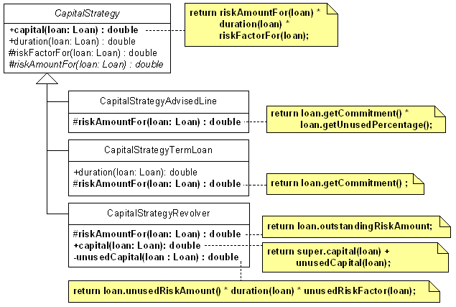
1.3 Template Method – Exercise Solution
TemplateMethod-Solution-Java.zip

Slide 23

1.4 Creation Method – Meet Your Maker
Overcome the limitations of Constructors by instead using explicit methods to produce new (or like new) products.
Most contemporary object-oriented languages use Constructors to create new instances of a given Class. However, Constructors present certain limitations. Creation Methods can be used to overcome some of these limitations.
Replace constructors with methods that return new objects.
Also Known As: Static Factory Method, Factory Method

Slide 24
1.4 Creation Method – Constructor Shortcomings
Constructors must have the same name as their class.
Constructors must return an instance of their class.
So, a Constructor may not have an intention revealing name, and may only return an instance of said class.
When either of these limitations poses a problem, you may consider using the Creation Method pattern.

Slide 25
1.4 Creation Method – Players
Consumer — (A.K.A. Client or Customer) an object that needs some product and invokes a Creation Method to get it.
Producer — an object that can produce the needed product. The Producer will have either a static or non-static Creation Method on it.
Product — the object to be produced.

Slide 26
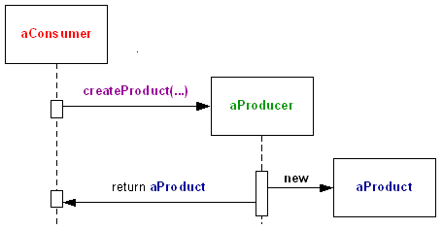
1.4 Creation Method – Players
Non-static

Slide 27
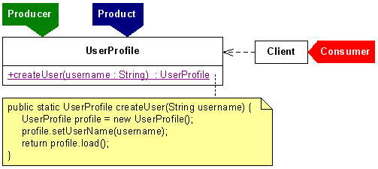
1.4 Creation Method – Players
Static
In this variation, UserProfile is both Producer and Product. It has a Creation Method that is static.

Slide 28
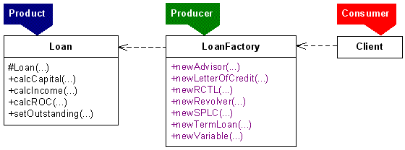
1.4 Creation Method – Players
Factory
In this example, LoanFactory has several non-static Creation Methods.
LoanFactory's sole purpose is to produce Loan instances. Notice that the Loan constructor is protected.

Slide 29
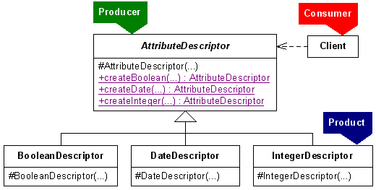
1.4 Creation Method – Players
Hierarchy
In this example, the Products are a subclass of the Producer and again, the Creation Methods are static:

Slide 30

1.5 Factory Method – Controlling the Means of Production
Define an interface for creating an object,
but let subclasses decide which class to instantiate.
Factory Method lets a class defer instantiation to subclasses.
[Design Patterns]

Slide 31
1.5 Factory Method – Players
Consumer — The object that wants a new Product to be created.
Product — The object that is created and delivered to the Consumer.
Producer — The object that manufactures the Product. This object may be a superclass or subclass within a hierarchy.
Factory Method — The polymorphic method in a class hierarchy that returns the Product.

Slide 32
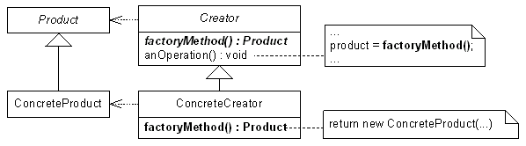
1.5 Factory Method – Variations
The Factory Method here is declared as abstract
in Creator and the Product is abstract.
This allows anOperation() to provide polymorphic instantiation of the product.

Slide 33
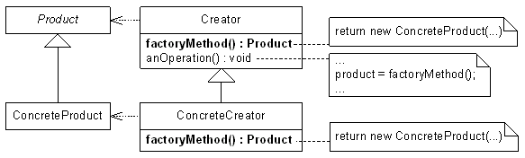
1.5 Factory Method – Variations
Here, Creator provides a default implementation for the Factory Method, while ConcreteCreator overrides the superclass implementation of the Factory Method.

Slide 34
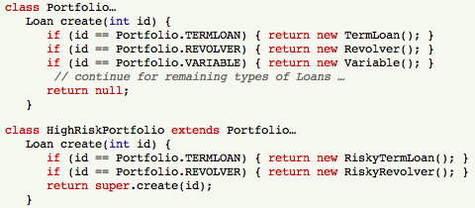
1.5 Factory Method – Variations
In this case, the Factory Method takes a
parameter that helps it select the resulting Product.

Slide 35
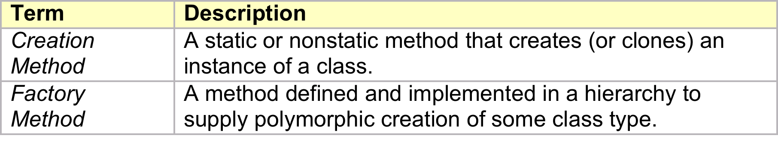
1.5 Factory Method – Differences with Creation Method
If a Creation Method is static (it need not be) then it would be equivalent to what people call a Static Factory Method.
Once a method becomes static, it cannot be a Factory Method since Factory Methods are implemented using inheritance and you don't get inheritance with static methods.
Finally, a Creation Method is most definitely NOT a Factory Method, as the table below shows:

Slide 36
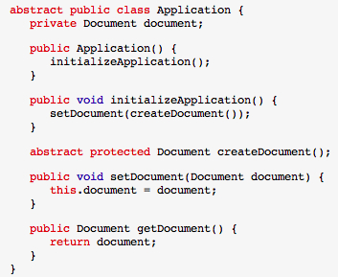
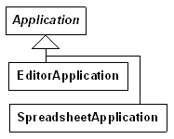
1.5 Factory Method – Example

Slide 37
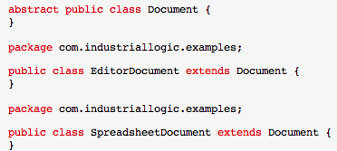
1.5 Factory Method – Example

Slide 38
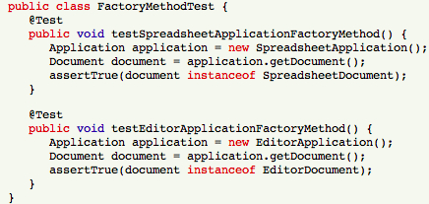
1.5 Factory Method – Example

Slide 39
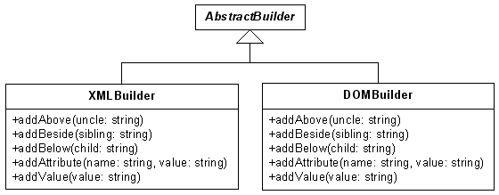
1.5 Factory Method – Exercise
Remove the duplication is this project with Factory method and Template Method
FactoryMethod-Problem-Java.zip

Slide 40
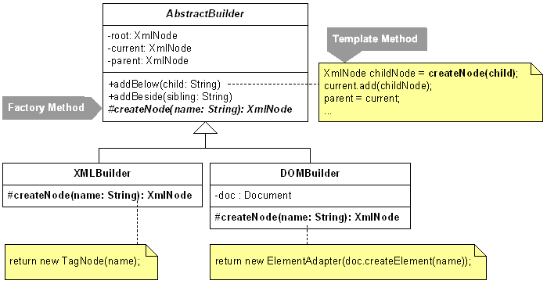
1.5 Factory Method – Exercise Solution
Notice that each of the add(...) methods is now a Template Method.
FactoryMethod-Solution-Java.zip

Slide 41
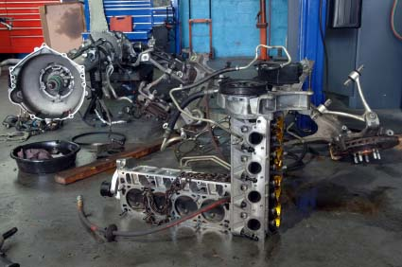
1.6 Abstract Factory – Distinguishing the Brand
Provide an interface for creating families of related or dependent objects without specifying their concrete classes. [Design Patterns]

Slide 42
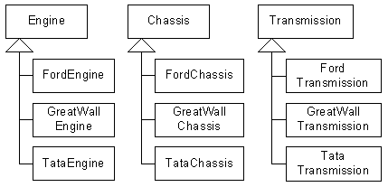
1.6 Abstract Factory – Example
The parts below are all made by automakers,
Ford, Great Wall and Tata.

Slide 43
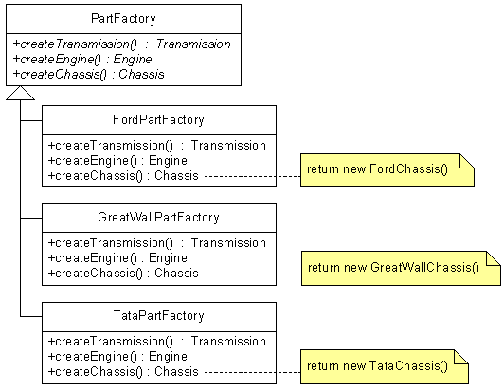
1.6 Abstract Factory – Example
Each automaker has its own Factory:
AbstractFactorySoCool-Example-Java.zip

Slide 44
Thank you.

